Slide 1
Grace Health Fresh Food Pharmacy

Slide 2
Program Overview
Provide nutritious foods and health coaching to food insecure clinic patients who are managing chronic nutrition related conditions

Slide 3
Partners

Slide 4
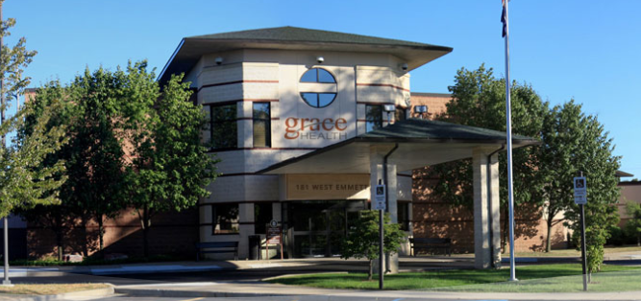
Partners

Slide 5
Fresh Food Pharmacy Intro
Nutrition Health
Clinic provides “prescription food”

Slide 6
Why Food as Medicine?
Food Insecurity
Health Disparities & Disease
Poorly Managed Health
Continued Food Insecurity

Slide 7
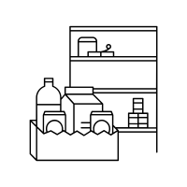
Grace Health Pilot
Design and pilot replicable model for fresh food pharmacies between food bank and FQHC partnerships

Slide 8
Project Goals
Short Term: Pilot Study (~1 year)
Food Security
Health Outcomes
Healthcare Cost
Long Term:
Scalability and Sustainability
Long Term Funding

Slide 9
Research and Evaluation
Patients
Health Metrics
Behavior Change Survey
Fresh Food Pharmacy Use
Process improvement – focus groups
Food Bank and Grace Health Staff
Process improvement – focus groups

Slide 10
Who Can Participate?
Grace Health Patients
Food Insecure
Nutrition Related Chronic Disease
Diabetes
Pre Diabetes
Gestational Diabetes
High Blood Pressure
Obesity
Willing to prepare food boxes & participate in health coaching

Slide 11
Patients Receive
From South Michigan Food Bank
Food Box – Delivered Biweekly
Recipe and Nutrition Tips Book with Recipe Videos
Cooking “Kick Off” kit
From Grace Health
Clinic Healthcare
Monthly Health Coaching

Slide 12
Food Box Details
Biweekly Cycle Menu
3 choices each cycle - 6 boxes total
Printed Recipes
Box Labels
For type of box (3 each cycle)
Allergens (milk choice)

Slide 13
Food Box Details
Each patient receives food biweekly (delivered to their home)
Low enrollment, biweekly food box packing
High enrollment, weekly may be needed

Slide 14
Food Box Menus
Cycle A
Box A1
Box A2
Box A3
Cycle A on Weeks 1 and 2
Cycle B on Weeks 3 and 4
Cycle B
Box B1
Box B2
Box B3

Slide 15
Menu Example Cycle A1
Dozen eggs (staple)
Cereal or oats (staple)
Milk (staple)
Frozen/fresh fruit - apples (staple)
Frozen/fresh vegetable (staple)
1# ground turkey (turkey tacos)
Head lettuce (turkey tacos)
2 tomatoes (turkey tacos)
8 oz cheese (cheddar or Mexican) (turkey tacos)
1 can pinto beans (or black bean or other) (turkey tacos)
16 taco shells (hard or soft) (turkey tacos)
2 cans black beans (soup)
1 onion (soup)
1 # carrots (soup)
1# Celery (soup)
Apples – 1 for soup, more for other recipes (soup)
1 can corn (or frozen) (soup)

Slide 16
Kick off Event
January 28th from 5:30 – 7:00 pm
Food distribution at Grace Health
Advertising Fresh Food Pharmacy Program

Slide 17
Project Timeframe
February/March Launch
6 month enrollment
9-12 months total length
(March 2021 – March 2022)

Slide 18
Number of Patients Expected
Goal: 350
Begin enrollment in March, maybe 50 and scaling up

Slide 19
Questions?

